Slide 1
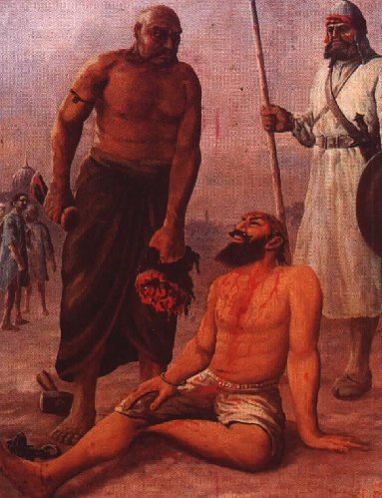
Bhai Taru Singh http://en.wikipedia.org/wiki/Bhai_Taru_Singh

Slide 2
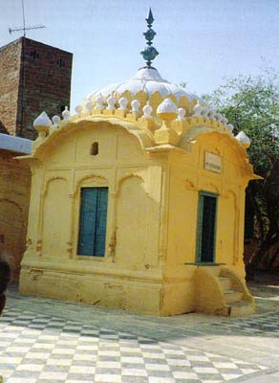
Gurudwara Bhai Taru Singh Ji Saheed Naulakha Bazar Lahore

